Slide 1
Agile Models
5/7/2020

Slide 2
What is Agile Software Development?
Agile: Easily moved, light, nimble, active software processes
How agility achieved?
Fitting the process to the project
Avoidance of things that waste time
Notes:
Agile SE -> Agile SD
How many have heard of Agile Software Development?
What does the word Agile mean? Anyone?
Latin word agilis, which means “easily moved, light, nimble, active”.
3. Agile Software development – defined as easily moved, light, nimble, and active software processes.
(Agile processes are not unique to software development. They appeared in mainstream business literature in 1991 in the form of Agile manufacturing.)
4. Fitting the process… Not project to the process.
Battlefield commanders plan extensively when going to war -> but realize that their plans are just the beginning. Creating and responding to change are very important.
Success is defined by accomplishing the mission (defeating the enemy) not conforming to the plan.
Can you image a commander saying, “We lost the battle but by golly we were successful because we followed our plan to the letter.”
Or “If we just plan this battle long and hard enough, and put repeatable processes in place, we can eliminate change early and not have to deal with it later.”
Pretty unreasonable.

Slide 3
Agile Model
To overcome the shortcomings of the waterfall model of development.
Proposed in mid-1990s
The agile model was primarily designed:
To help projects to adapt to change requests
In the agile model:
The requirements are decomposed into many small incremental parts that can be developed over one to four weeks each.

Slide 4
Ideology: Agile Manifesto
Individuals and interactions over
process and tools
Working Software over
comprehensive documentation
Customer collaboration over
contract negotiation
Responding to change over
following a plan
http://www.agilemanifesto.org
Notes:
Idealisms
Over instead of versus is because they are all good ideals
Rework vs. Reuse – everything should be production quality, but reworkable for flexibility. Don’t be afraid of partial solutions.
Military Adoption of the 80% solution.
Responding to Change – in line with Lucy Suchman’s Plans and Situated Actions, with the trukese and european navigators.

Slide 5
Agile Methodologies
XP
Scrum
Unified process
Crystal
DSDM
Lean

Slide 6
Agile Model: Principal Techniques
User stories:
Simpler than use cases.
Metaphors:
Based on user stories, developers propose a common vision of what is required.
Spike:
Simple program to explore potential solutions.
Refactor:
Restructure code without affecting behavior, improve efficiency, structure, etc.

Slide 7
Agile Model: Nitty Gritty
At a time, only one increment is planned, developed, deployed at the customer site.
No long-term plans are made.
An iteration may not add significant functionality,
But still a new release is invariably made at the end of each iteration
Delivered to the customer for regular use.

Slide 8
Methodology
Face-to-face communication favoured over written documents.
To facilitate face-to-face communication,
Development team to share a single office space.
Team size is deliberately kept small (5-9 people)
This makes the agile model most suited to the development of small projects.

Slide 9
Effectiveness of Communication Modes
Notes:
Software development is a communication game
Documentation is the worst way to communicate
Whatever your situation, use the most effective means at your disposal to communicate
http://www.agilemodeling.com/essays/communication.htm

Slide 10
Agile Model: Principles
The primary measure of progress:
Incremental release of working software
Important principles behind agile model:
Frequent delivery of versions --- once every few weeks.
Requirements change requests are easily accommodated.
Close cooperation between customers and developers.
Face-to-face communication among team members.

Slide 11
Agile Documentation
Travel light:
You need far less documentation than you think.
Agile documents:
Are concise
Describe information that is less likely to change
Describe “good things to know”
Are sufficiently accurate, consistent, and detailed
Valid reasons to document:
Project stakeholders require it
To define a contract model
To support communication with an external group
To think something through

Slide 12
Agile Software Requirements Management

Slide 13
Adoption Detractors
Sketchy definitions, make it possible to have
Inconsistent and diverse definitions
High quality people skills required
Short iterations inhibit long-term perspective
Higher risks due to feature creep:
Harder to manage feature creep and customer expectations
Difficult to quantify cost, time, quality.
Notes:
Why not more adoption (in SE? in corporate? In universities?)
Inconsistent and diverse defs – need more quality methodology not just quantity.
Lack of Theoretical Grounding – current concept of agility based on experience, not on underlying concepts like flexibility and leanness. Agile methods like SCRUM and XP are derived from subjective practical experience and not reliable systematic research.
But there is hope… Conboy et. Al. and their framework of agility for software development (based on underlying concepts);
Role changes – management role less prominent and active, more like a coach
Situational customization – no out of the box operation. Takes time to customize a process and get good at it.
Difficult to quantify – Agile practices are more philosophy based not activity based.
Risks – Making the customer understand the tradeoffs for following them down a rabbit hole can be difficult.
How do you budget a project if you can’t get the all/most requirements upfront?

Slide 14
Agile Model Shortcomings
Derives agility through developing tacit knowledge within the team, rather than any formal document:
Can be misinterpreted…
External review difficult to get…
When project is complete, and team disperses, maintenance becomes difficult…

Slide 15
Agile Model versus Waterfall Model
Steps of Waterfall model are a planned sequence:
Requirements-capture, analysis, design, coding, and testing .
Progress is measured in terms of delivered artefacts:
Requirement specifications, design documents, test plans, code reviews, etc.
In contrast agile model sequences:
Delivery of working versions of a product in several increments.

Slide 16
Agile Model versus Iterative Waterfall Model
As regards to similarity:
We can say that Agile teams use the waterfall model on a small scale.

Slide 17
Agile versus RAD Model
Agile model does not recommend developing prototypes:
Systematic development of each incremental feature is emphasized.
In contrast:
RAD is based on designing quick-and-dirty prototypes, which are then refined into production quality code.

Slide 18
Agile versus exploratory programming
Similarity:
Frequent re-evaluation of plans,
Emphasis on face-to-face communication,
Relatively sparse use of documents.
Agile teams, however, do follow defined and disciplined processes and carry out rigorous designs:
This is in contrast to chaotic coding in exploratory programming.

Slide 19
Extreme Programming (XP)

Slide 20
Extreme Programming Model
Extreme programming (XP) was proposed by Kent Beck in 1999.
The methodology got its name from the fact that:
Recommends taking the best practices to extreme levels.
If something is good, why not do it all the time.

Slide 21
Taking Good Practices to Extreme
If code review is good:
Always review --- pair programming
If testing is good:
Continually write and execute test cases --- test-driven development
If incremental development is good:
Come up with new increments every few days
If simplicity is good:
Create the simplest design that will support only the currently required functionality.

Slide 22
Taking to Extreme
If design is good,
everybody will design daily (refactoring)
If architecture is important,
everybody will work at defining and refining the architecture (metaphor)
If integration testing is important,
build and integrate test several times a day (continuous integration)

Slide 23
4 Values
Communication:
Enhance communication among team members and with the customers.
Simplicity:
Build something simple that will work today rather than something that takes time and yet never used
May not pay attention for tomorrow
Feedback:
System staying out of users is trouble waiting to happen
Courage:
Don’t hesitate to discard code

Slide 24
Best Practices
Coding:
without code it is not possible to have a working system.
Utmost attention needs to be placed on coding.
Testing:
Testing is the primary means for developing a fault-free product.
Listening:
Careful listening to the customers is essential to develop a good quality product.

Slide 25
Best Practices
Designing:
Without proper design, a system implementation becomes too complex
The dependencies within the system become too numerous to comprehend.
Feedback:
Feedback is important in learning customer requirements.

Slide 26
Extreme Programming Activities
XP Planning
Begins with the creation of “user stories”
Agile team assesses each story and assigns a cost
Stories are grouped to for a deliverable increment
A commitment is made on delivery date
XP Design
Follows the KIS principle
Encourage the use of CRC cards
For difficult design problems, suggests the creation of “spike solutions”—a design prototype
Encourages “refactoring”—an iterative refinement of the internal program design

Slide 27
Extreme Programming Activities
XP Coding
Recommends the construction of unit test cases before coding commences (test-driven development)
Encourages “pair programming”
XP Testing
All unit tests are executed daily
“Acceptance tests” are defined by the customer and executed to assess customer visible functionalities

Slide 28
Full List of XP Practices
Planning – determine scope of the next release by combining business priorities and technical estimates
Small releases – put a simple system into production, then release new versions in very short cycles
Metaphor – all development is guided by a simple shared story of how the whole system works
Simple design – system is to be designed as simple as possible
Testing – programmers continuously write and execute unit tests

Slide 29
Full List of XP Practices
Refactoring – programmers continuously restructure the system without changing its behavior to remove duplication and simplify
Pair-programming -- all production code is written with two programmers at one machine
Collective ownership – anyone can change any code anywhere in the system at any time.
Continuous integration – integrate and build the system many times a day – every time a task is completed.

Slide 30
Full List of XP Practices
40-hour week – work no more than 40 hours a week as a rule
On-site customer – a user is a part of the team and available full-time to answer questions
Coding standards – programmers write all code in accordance with rules emphasizing communication through the code

Slide 31
Emphasizes Test-Driven Development (TDD)
Based on user story develop test cases
Implement a quick and dirty feature every couple of days:
Get customer feedback
Alter if necessary
Refactor
Take up next feature

Slide 32
Project Characteristics that Suggest Suitability of Extreme Programming
Projects involving new technology or research projects.
In this case, the requirements change rapidly and unforeseen technical problems need to be resolved.
Small projects:
These are easily developed using extreme programming.

Slide 33
Life Cycle Models: Scrum

Slide 34
Practice Questions
What are the stages of iterative waterfall model?
What are the disadvantages of the iterative waterfall model?
Why has agile model become so popular?
What difficulties might be faced if no life cycle model is followed for a certain large project?

Slide 35
Suggest Suitable Life Cycle Model
A software for an academic institution to automate its:
Course registration and grading
Fee collection
Staff salary
Purchase and store inventory
The software would be developed by tailoring a similar software that was developed for another educational institution:
70% reuse
10% new code and 20% modification

Slide 36
Practice Questions
Which types of risks can be better handled using the spiral model compared to the prototyping model?
Which type of process model is suitable for the following projects:
A customization software
A payroll software for contract employees that would be add on to an existing payroll software

Slide 37
Practice Questions
Which lifecycle model would you select for the following project which has been awarded to us by a mobile phone vendor:
A new mobile operating system by upgrading the existing operating system
Needs to work well efficiently with 4G systems
Power usage minimization
Directly upload backup data on a cloud infrastructure maintained by the mobile phone vendor

Slide 38
Scrum

Slide 39
Scrum: Characteristics
Self-organizing teams
Product progresses in a series of month-long sprints
Requirements are captured as items in a list of product backlog
One of the agile processes

Slide 40
Daily Scrum
Sprint
planning
Sprint
review
Scrum
Sprint
backlog
Product backlog
Product
increment

Slide 41
Sprint
Scrum projects progress in a series of “sprints”
Analogous to XP iterations or time boxes
Target duration is one month
Software increment is designed, coded, and tested during the sprint
No changes entertained during a sprint

Slide 42
Scrum Framework
Roles : Product Owner, Scrum Master, Team
Ceremonies : Sprint Planning, Sprint Review, Sprint Retrospective, and Daily Scrum Meeting
Artifacts : Product Backlog, Sprint Backlog, and Burndown Chart

Slide 43
Key Roles and Responsibilities in a Scrum Team
Product Owner
Represents customers’ views and interests.
Development Team
Team of five-nine people with cross-functional skill sets.
Scrum Master (aka Project Manager)
Facilitates scrum process and resolves impediments at the team and organization level by acting as a buffer between the team and outside interference.

Slide 44
Product Owner
Defines the features of the product
Decides on release date and content
Prioritizes features according to usefullness
Adjusts features and priority every iteration, as needed
Accepts or reject work results.

Slide 45
The Scrum Master
Represents management in the project
Removes impediments
Ensures that the team is fully functional and productive
Enables close cooperation across all roles and functions
Shields the team from external interferences

Slide 46
Scrum Team
Typically 5-10 people
Cross-functional
QA, Programmers, UI Designers, etc.
Teams are self-organizing
Membership can change only between sprints

Slide 47
Sprint
Fundamental process flow of Scrum
It is usually a month-long iteration:
during this time an incremental product functionality completed
NO outside influence allowed to interfere with the Scrum team during the Sprint
Each day begins with the Daily Scrum Meeting

Slide 48
Ceremonies
Sprint Planning Meeting
Daily Scrum
Sprint Review Meeting

Slide 49
Sprint Planning
Goal is to produce Sprint Backlog
Product owner works with the Team to negotiate what Backlog Items
Scrum Master ensures Team agrees to realistic goals

Slide 50
Daily Scrum
Daily
15-minutes
Stand-up meeting
Not for problem solving
Three questions:
What did you do yesterday
What will you do today?
What obstacles are in your way?

Slide 51
Daily Scrum
Is NOT a problem solving session
Is NOT a way to collect information about WHO is behind the schedule
Is a meeting in which team members review what is done and make informal commitments to each other and to the Scrum Master
Is a good way for a Scrum Master to track the progress of the Team

Slide 52
Sprint Review Meeting
Team presents what it accomplished during the sprint
Typically takes the form of a demo of new features
Informal
2-hour prep time rule
Participants
Customers
Management
Product Owner
Other team members

Slide 53
Product Backlog
A list of all desired work on the project
Usually a combination of
story-based work (“let user search and replace”)
task-based work (“improve exception handling”)
List is prioritized by the Product Owner
Typically a Product Manager, Marketing, Internal Customer, etc.

Slide 54
Product Backlog
Requirements for a system, expressed as a prioritized list of Backlog Items
Managed and owned by Product Owner
Spreadsheet (typically)

Slide 55
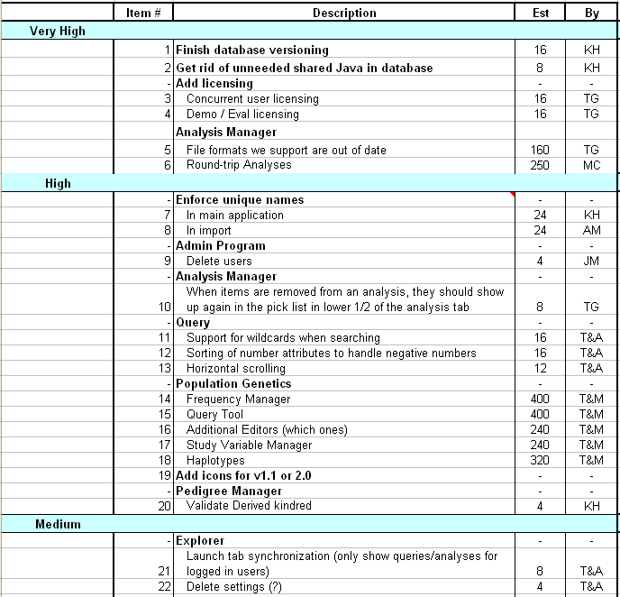
Sample Product Backlog

Slide 56
Sprint Backlog
A subset of Product Backlog Items, which define the work for a Sprint
Created by Team members
Each Item has it’s own status
Updated daily

Slide 57
Sprint Backlog during the Sprint
Changes occur:
Team adds new tasks whenever they need to in order to meet the Sprint Goal
Team can remove unnecessary tasks
But: Sprint Backlog can only be updated by the team
Estimates are updated whenever there’s new information

Slide 58
Burn down Charts
Are used to represent “work done”.
Are remarkably simple but effective Information disseminators
3 Types:
Sprint Burn down Chart (progress of the Sprint)
Release Burn down Chart (progress of release)
Product Burn down chart (progress of the Product)

Slide 59
Sprint Burn down Chart
Depicts the total Sprint Backlog hours remaining per day
Shows the estimated amount of time to complete
Ideally should burn down to zero to the end of the Sprint
Actually is not a straight line

Slide 60
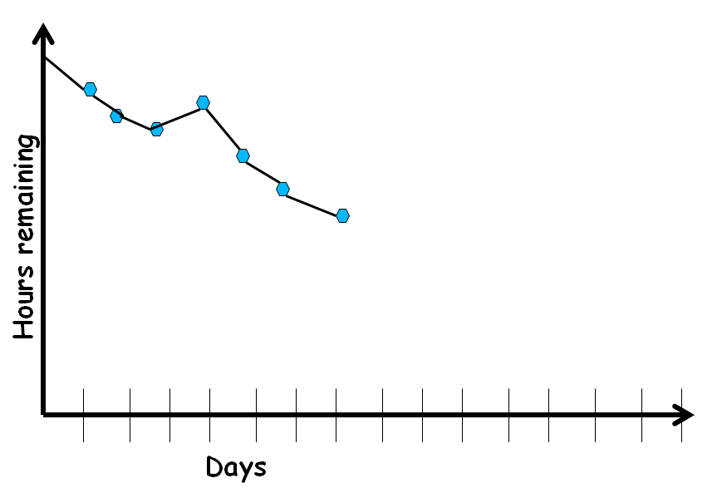
Sprint Burndown Chart

Slide 61
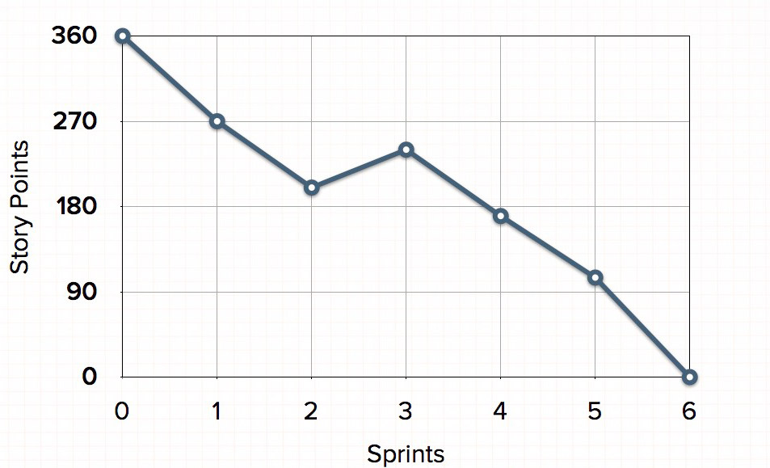
Release Burndown Chart
Will the release be done on right time?
How many more sprints?
X-axis: sprints
Y-axis: amount of story points remaining

Slide 62
Product Burndown Chart
Is a “big picture” view of project’s progress (all the releases)
Actual
burndown
Story
points
Expected
burndown
Sprint

Slide 63
Scalability of Scrum
A typical Scrum team is 6-10 people
Jeff Sutherland - up to over 800 people
"Scrum of Scrums" or "Meta-Scrum“

Slide 64
Thank You!!

